Slide 1


From Business Idea to Company Chapters 14-16

Slide 2
You have an idea, but limited money
Capital Rationing: A firm has positive NPV projects but cannot find the necessary financing
Soft Rationing: Different units in a business are allocated a certain amount of financing
Hard rationing: A business cannot raise financing for a project under any circumstances

Slide 3
Where do you get money from?
Your own savings
Angel investors
Often friends, family
Use their own money
May lend money (debt) or “buy in” (equity)
Venture Capitalists (think “Shark Tank”) → equity
Private Equity → equity
Banks: Loans

Slide 4
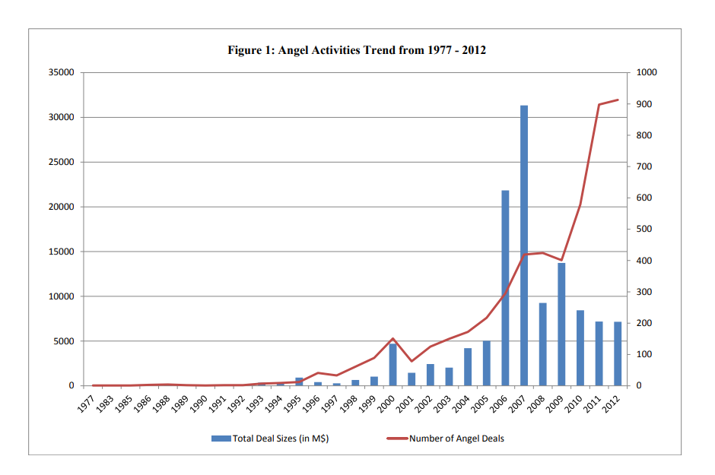
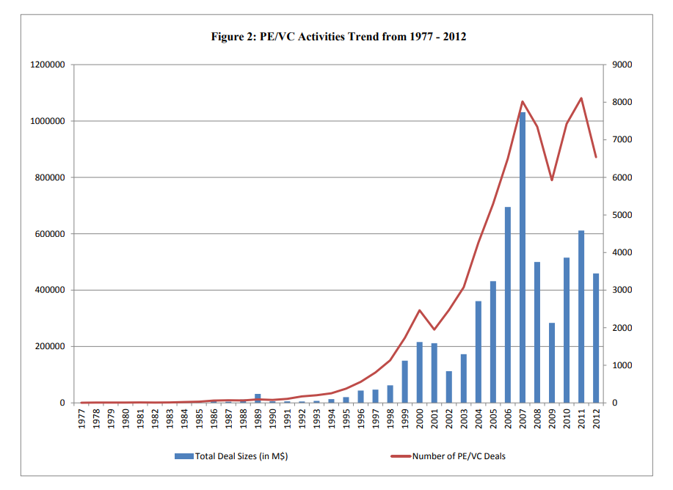
Cumming and Zhang, 2016

Slide 5
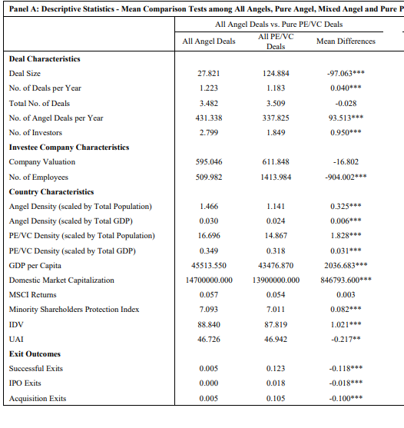
Please be advised that these are simple summary statistics, NOT causal relationships
Notes:
Cumming and Zhang, 2016

Slide 6
Going public: IPO (Initial Public Offering)
You sell X shares of your firm for $Y
Determined based on financial model
Roadshow
Prospectus / Red Herring
+ Advantages:
Ability to raise lots of money
Disadvantages:
Underpricing
Greater regulatory burden
Listening to shareholders
Costs of listing

Slide 7
IPO underpricing
You offer shares for $50, they immediately go up to $60 after offering

Slide 8
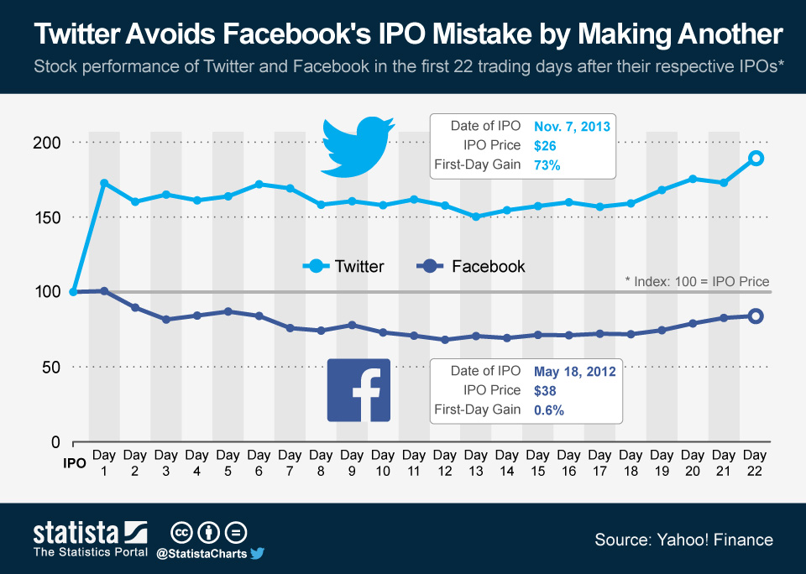

Slide 9
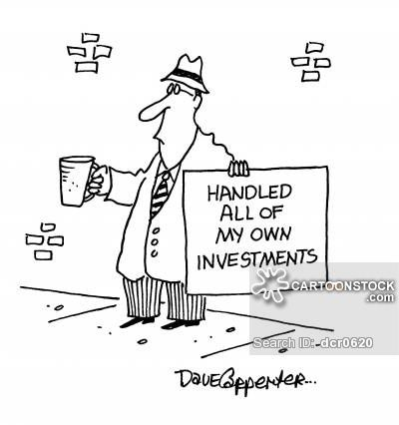
Are all bankers idiots?

Slide 10
Pricing is difficult!!! Underpricing..
Good for investment bank: Easy to sell all shares
Good for insiders: Gain money
But: “Left money on table”
Difficult to price a firm! Underpricing worse with high info-asymmetry
Reward for insider information
Winner’s curse

Slide 11
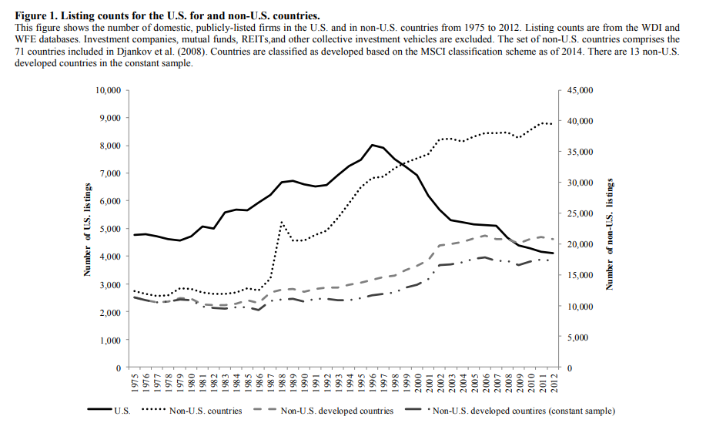
Doidge, Karolyi, Stulz (2015)

Slide 12
Two ways of raising capital:
Debt (“leverage”)
Loans
Bonds
You have to pay the money back + interest
Equity (Stocks)
Think “selling a piece of your company”
Shareholders / Stockholders NOT stakeholders OWN parts of the company
Only get money if any is left (dividends, buybacks)
Last in line to get paid when firm goes bankrupt (“residual claims”)

Slide 13
IN THEORY
How much debt vs. how much equity you choose does not matter!
Modigliani and Miller (Nobel Prize)

Slide 14
IN REALITY
Debt has a tax advantage
Bankruptcy costs
Direct
Indirect
Optimal capital structure:
Maximize tax advantage while minimizing your probability of financial distress

Slide 15
IN REALITY
Issuing Equity:
Signals to the market that shares are OVERpriced
Decreases share price

Slide 16
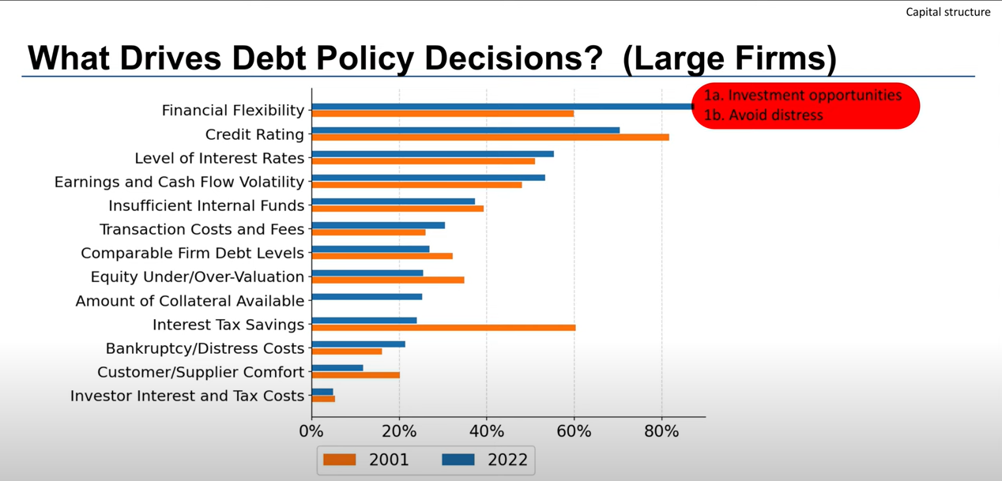

Slide 17
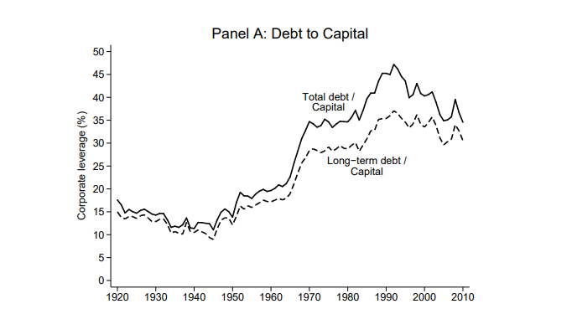
Graham, Leary, Roberts (2013)

Slide 18

The wacc

Slide 19
The cost of capital
Is a weighted average
Takes the tax benefit of debt into account
Wacc = weight(debt)*cost(debt)*(1-tax rate) + weight(equity)*cost(equity)
Notes:
https://deliverypdf.ssrn.com/delivery.php?ID=868103003064113116125098064075096092048007037010053025100074085005030121088003017112095073066067079075095036079089087094111001084097011091109010086117125023083091116098017004084103004026029&EXT=pdf&INDEX=TRUE

Slide 20
Using the wacc
Wacc can be used as a discount rate in the NPV calculation
THINK THROUGH THIS:
If wacc is higher, what does this mean for NPV?
If tax rate is higher (lower), what does that mean for wacc?
What does that mean for NPV?
Wacc can be used as a discount rate when valuing companies
More on this later

